Slide 1
Computer Vision
The slides are mostly adopted from material developed by:
Dr. Aiman El-Maleh, KFUPM, COE Department

Slide 2
Outline
Image Representation
What is Computer Vision
Computer Vision Challenges
Computer Vision Tasks
Computer Vision Applications
Convolutional Neural Networks (CNNs)

Slide 3
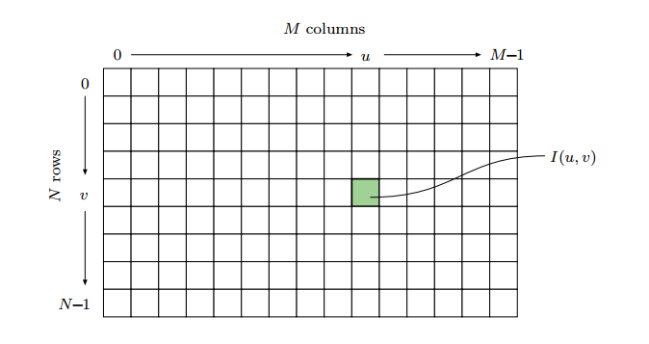
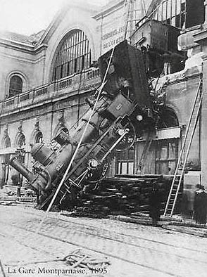
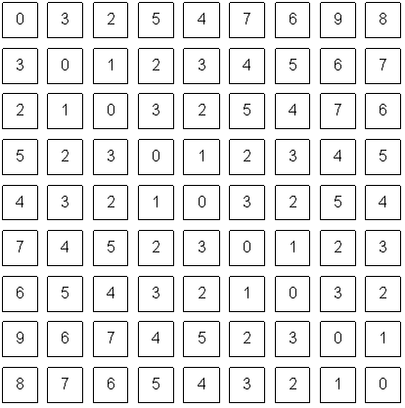
Image Representation
In image processing, the coordinate system is flipped in the vertical direction. The origin of the axis will be at the left top corner.
Each square in the coordinate plane is known as a pixel.
Each pixel will hold a quantized value acquired when capturing an image.
A gray-level image is a scalar image with 0 = black and 2⁸ − 1 =255= white

Slide 4
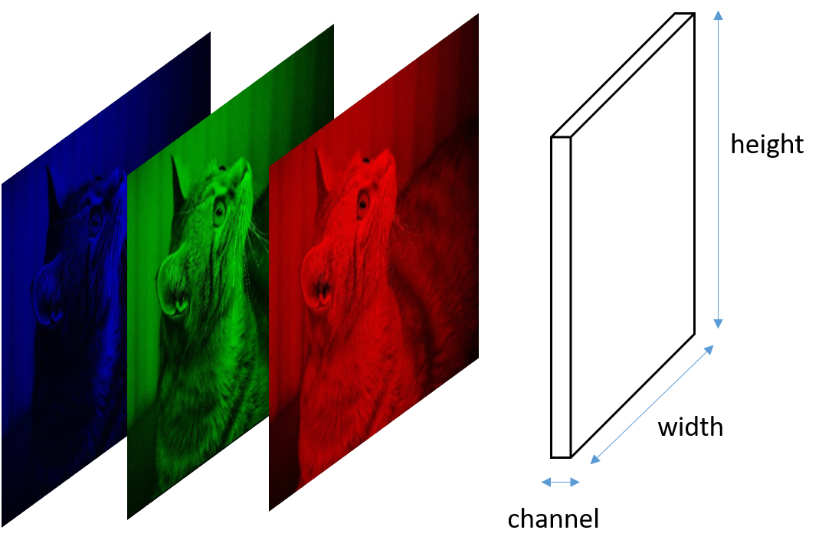
Colored Images Representation
In a colored image, the color is composed of three channels red, green and blue.
How does a computer see this image?
Computers see the matrix
Unlike grayscale images where we had only one channel, color images have three matrices stacked on top of each other.

Slide 5
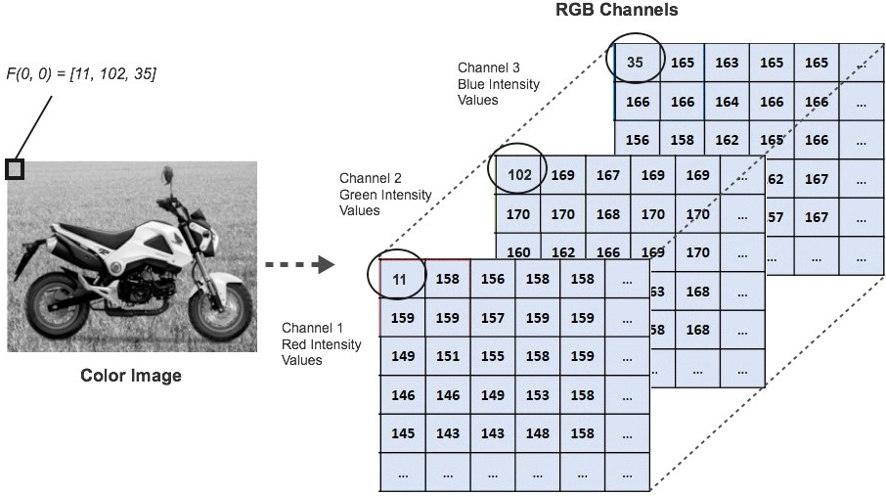
Colored Images Representation

Slide 6
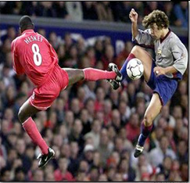
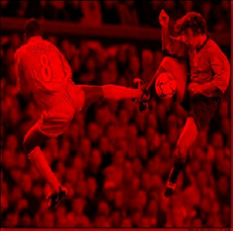
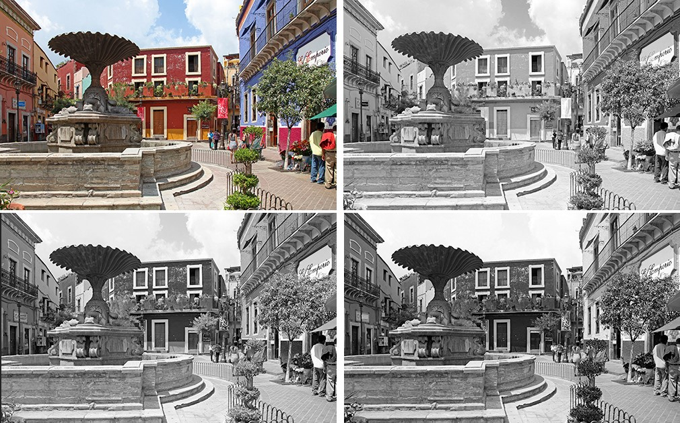
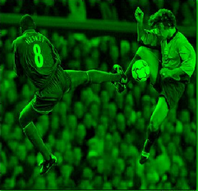
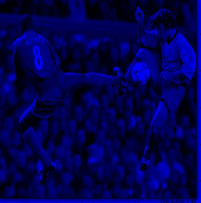
Colored Images Representation
Red
Green
Blue

Slide 7
What is Computer Vision
Computer vision encompasses the different computational methods for analyzing and understanding digital images
The goal of computer vision is to give computers (super) human-level perception
Mimicking the human perception of sight with computational algorithms
Converting images to more understandable things like distance, edges, directions etc.
Computer getting information out of images/video
Giving the computer "eyes" to see and identify as humans would

Slide 8
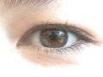
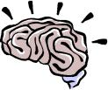
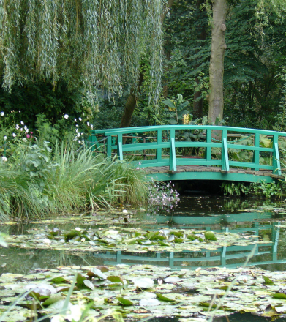
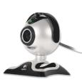
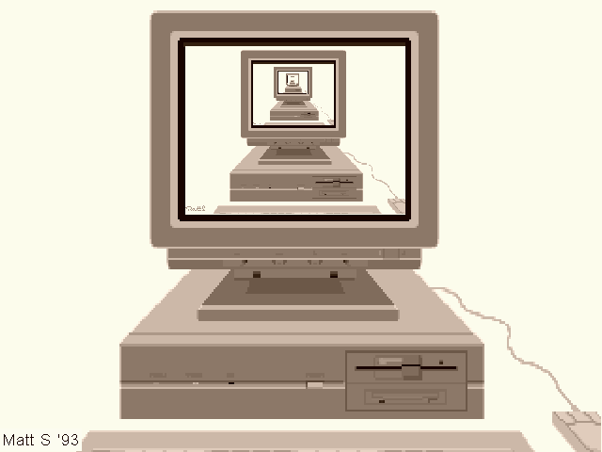
What is Computer Vision
Image (or video)
Sensing device
Interpreting device
Interpretations
garden, spring,
bridge, water,
trees, flower,
green, etc.

Slide 9
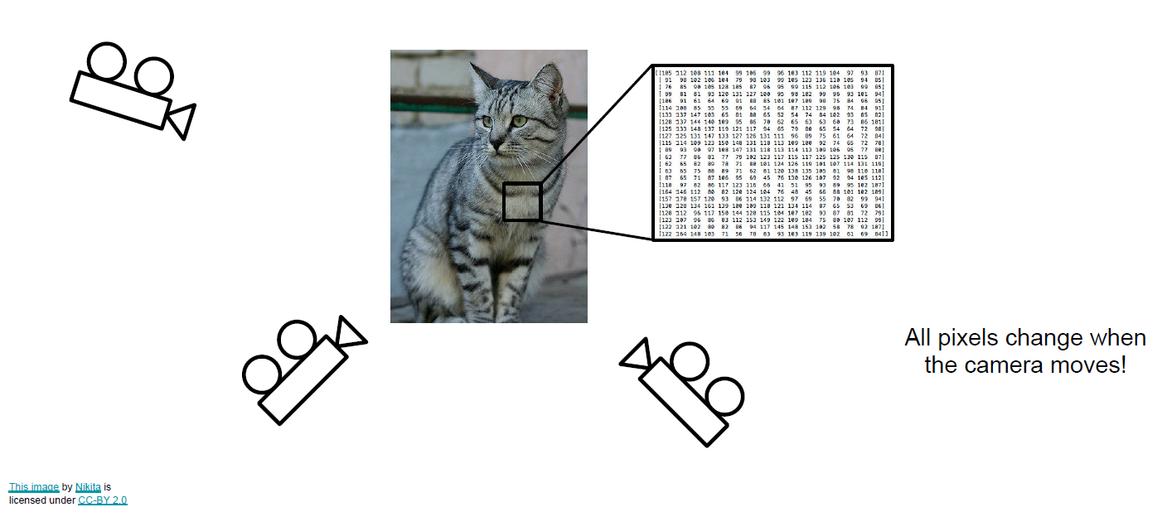
Computer Vision Challenges
Viewpoint Variation

Slide 10
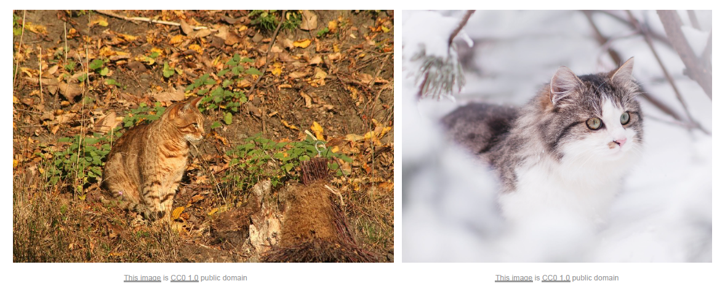
Computer Vision Challenges
Background Clutter

Slide 11
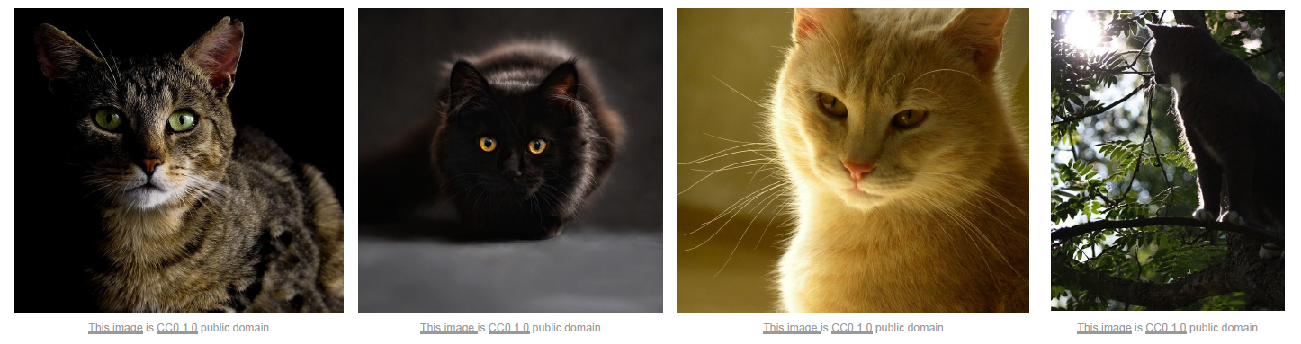
Computer Vision Challenges
Illumination

Slide 12
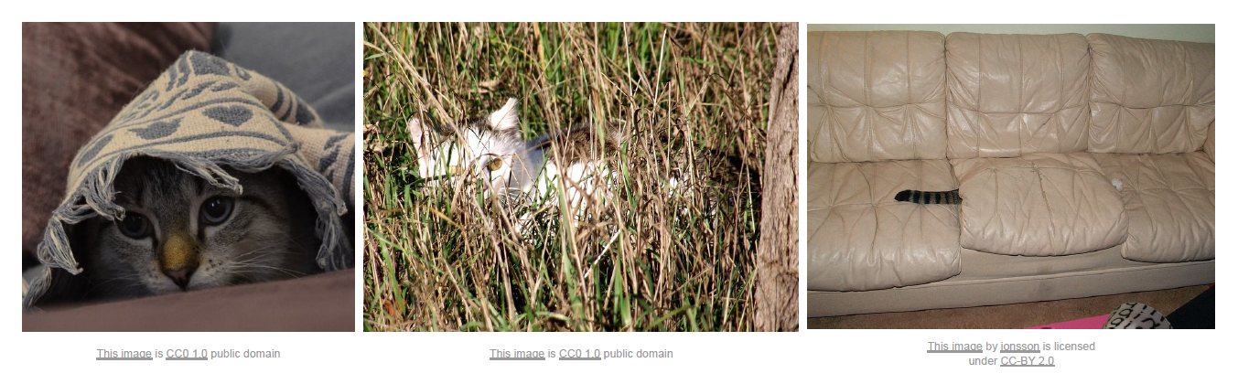
Computer Vision Challenges
Occlusion

Slide 13
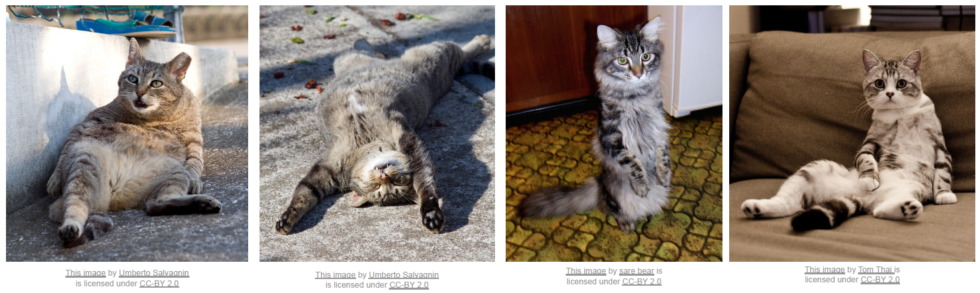
Computer Vision Challenges
Deformation

Slide 14
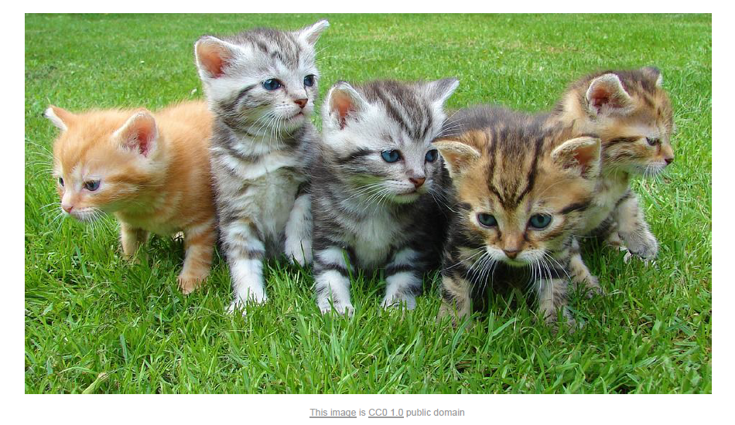
Computer Vision Challenges
Intraclass Variation

Slide 15
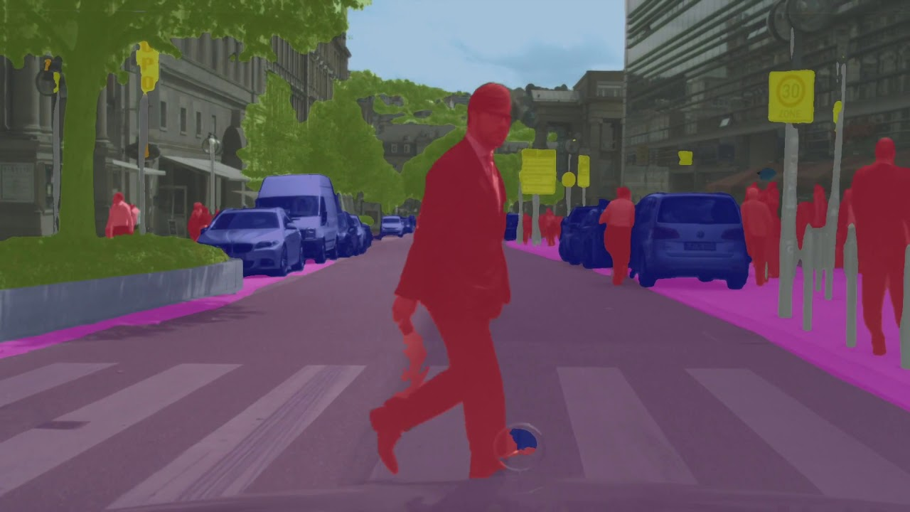
Computer Vision Tasks
Low Level Vision
Measurements
Enhancements
Region segmentation
Features
Mid Level Vision
Reconstruction
Depth
Motion Estimation
High Level Vision
Category detection
Activity recognition
Deep understandings
Pose estimation

Slide 16
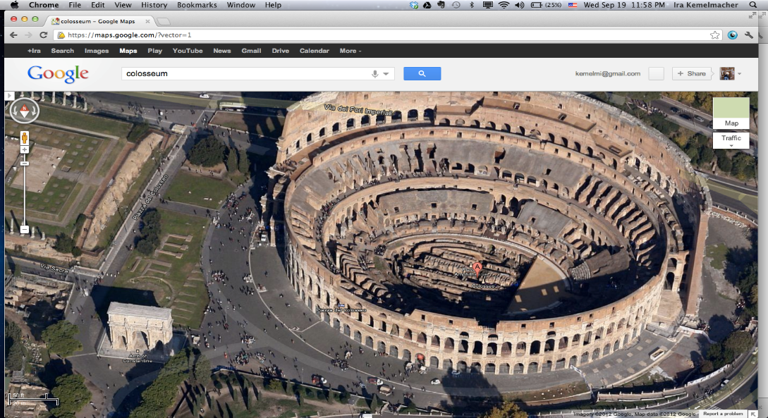
Computer Vision Tasks
Low Level Vision
Measurements
Enhancements
Region segmentation
Features
Mid Level Vision
Reconstruction
Depth
Motion Estimation
High Level Vision
Category detection
Activity recognition
Deep understandings
Pose estimation
Structure estimation
from photos

Slide 17
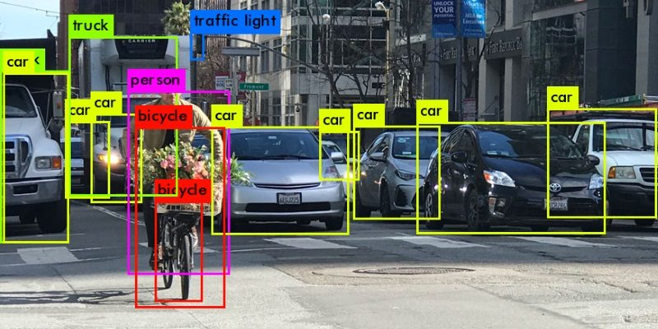
Computer Vision Tasks
Low Level Vision
Measurements
Enhancements
Region segmentation
Features
Mid Level Vision
Reconstruction
Depth
Motion Estimation
High Level Vision
Category detection
Activity recognition
Deep understandings
Pose estimation

Slide 18
Computer Vision Applications
Laptop: Biometrics auto-login (face recognition, 3D), OCR
Smartphones: QR codes, computational photography (Android Lens Blur, iPhone Portrait Mode), panorama construction (Google Photo Spheres), face detection, expression detection (smile), Snapchat filters (face tracking), Google Tango (3D reconstruction), Night Sight (Pixel)
Web: Image search, Google photos (face recognition, object recognition, scene recognition, geolocalization from vision), Facebook (image captioning), Google maps aerial imaging (image stitching), YouTube (content categorization)
VR/AR: Outside-in tracking (HTC VIVE), inside out tracking (simultaneous localization and mapping, HoloLens), object occlusion (dense depth estimation)

Slide 19
Computer Vision Applications
Motion: Kinect, full body tracking of skeleton, gesture recognition, virtual try-on
Medical imaging: CAT / MRI reconstruction, assisted diagnosis, automatic pathology, connectomics, endoscopic surgery
Industry: Vision-based robotics (marker-based), machine-assisted router (jig), automated post, ANPR (number plates), surveillance, drones, shopping
Transportation: Assisted driving (everything), face tracking/iris dilation for drunkeness, drowsiness, automated distribution
Media: Visual effects for film, TV (reconstruction), virtual sports replay (reconstruction), semantics-based auto edits
https://www.cs.ubc.ca/~lowe/vision.html

Slide 20


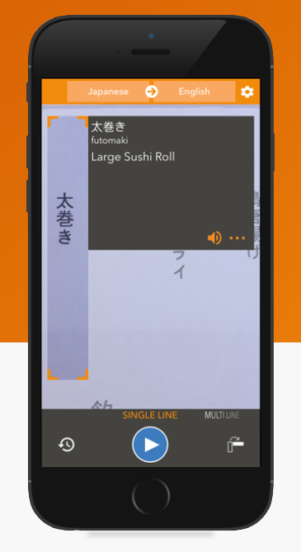
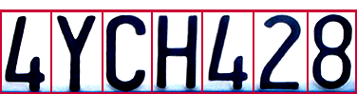
Computer Vision Applications
Optical Character Recognition (OCR): Technology to convert images of text into text. Scanners come with OCR software.
Live Camera Translation
Mail digit recognition, AT&T labs
License plate readers
http://en.wikipedia.org/wiki/Automatic_number_plate_recognition

Slide 21
Computer Vision Applications
Object Recognition
Toshiba Tech
IS-910T
2013
DataLogic
LaneHawk
LH4000
2012

Slide 22
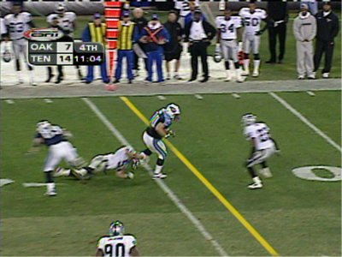
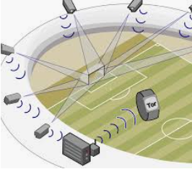
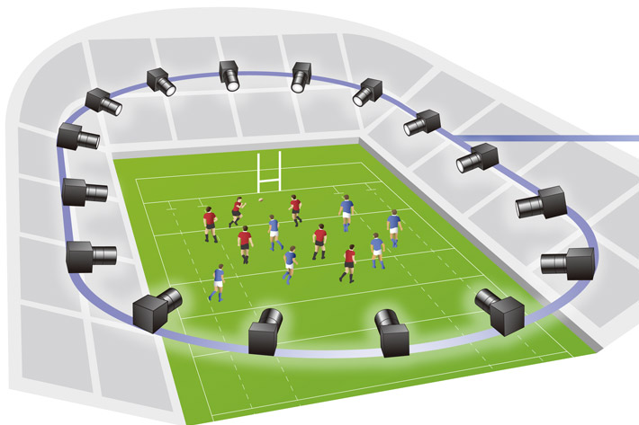
Computer Vision Applications
Sports
Sportvision first down line
GoalControl-4D System
Free Viewpoint- Canon

Slide 23
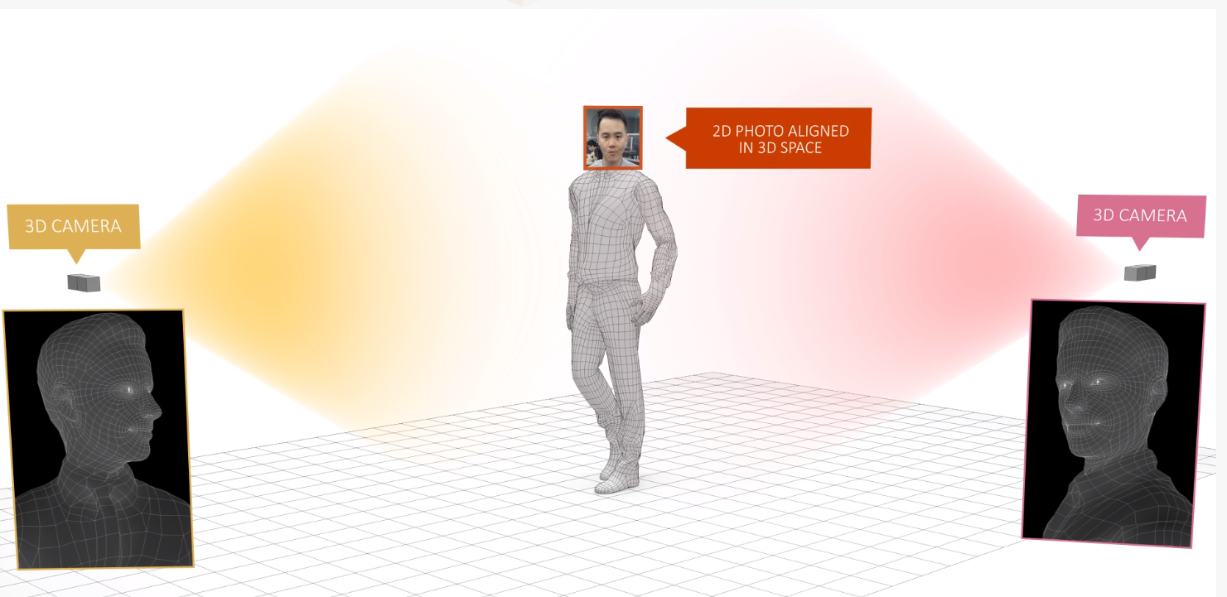
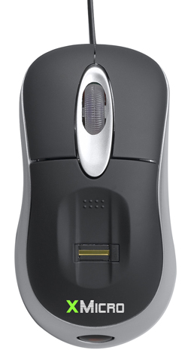
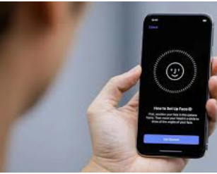
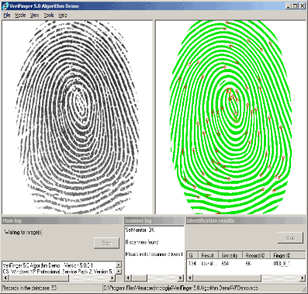
Computer Vision Applications
Vision-based Biometrics
Apple Face ID
Fingerprint scanners on many new laptops, other devices
Face recognition systems now beginning to appear more widely http://www.sensiblevision.com/

Slide 24
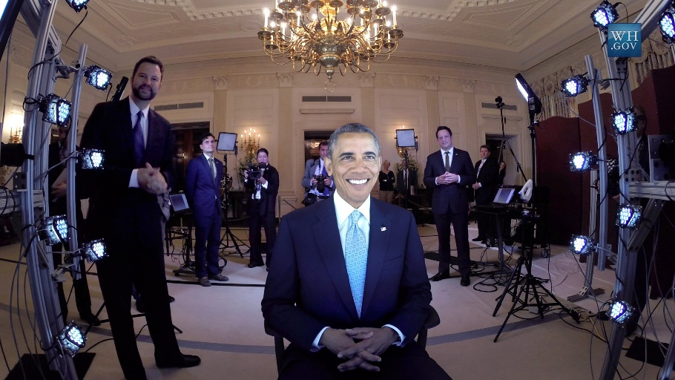
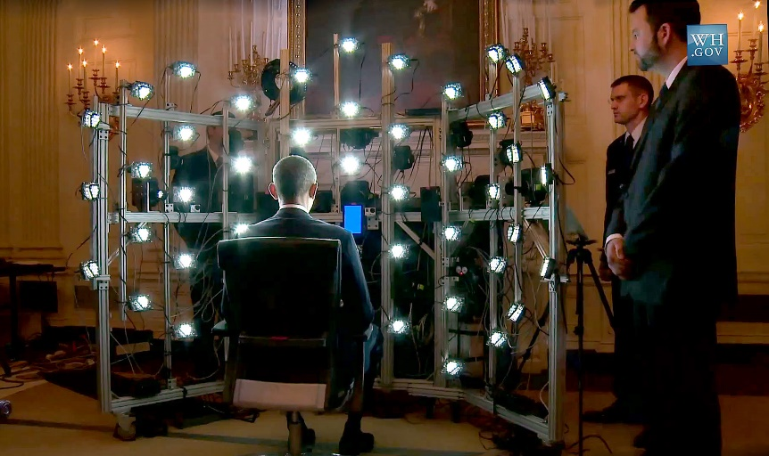
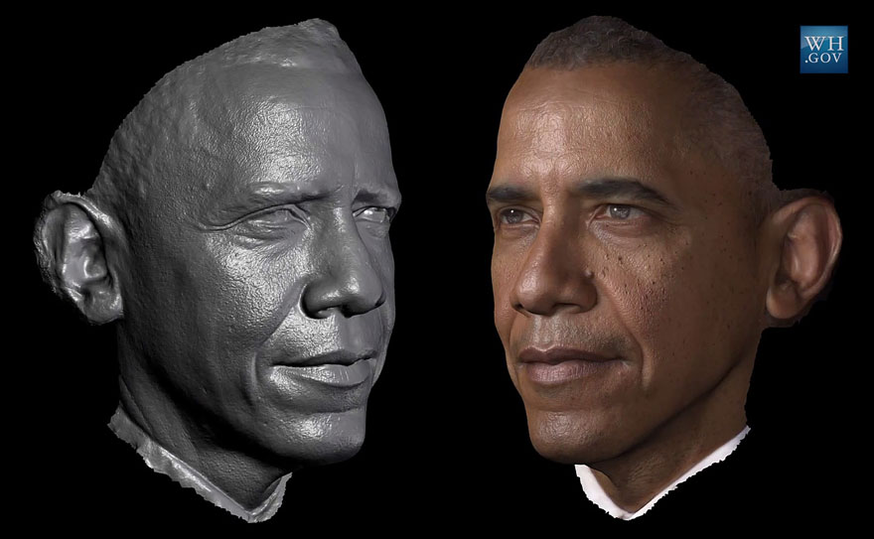
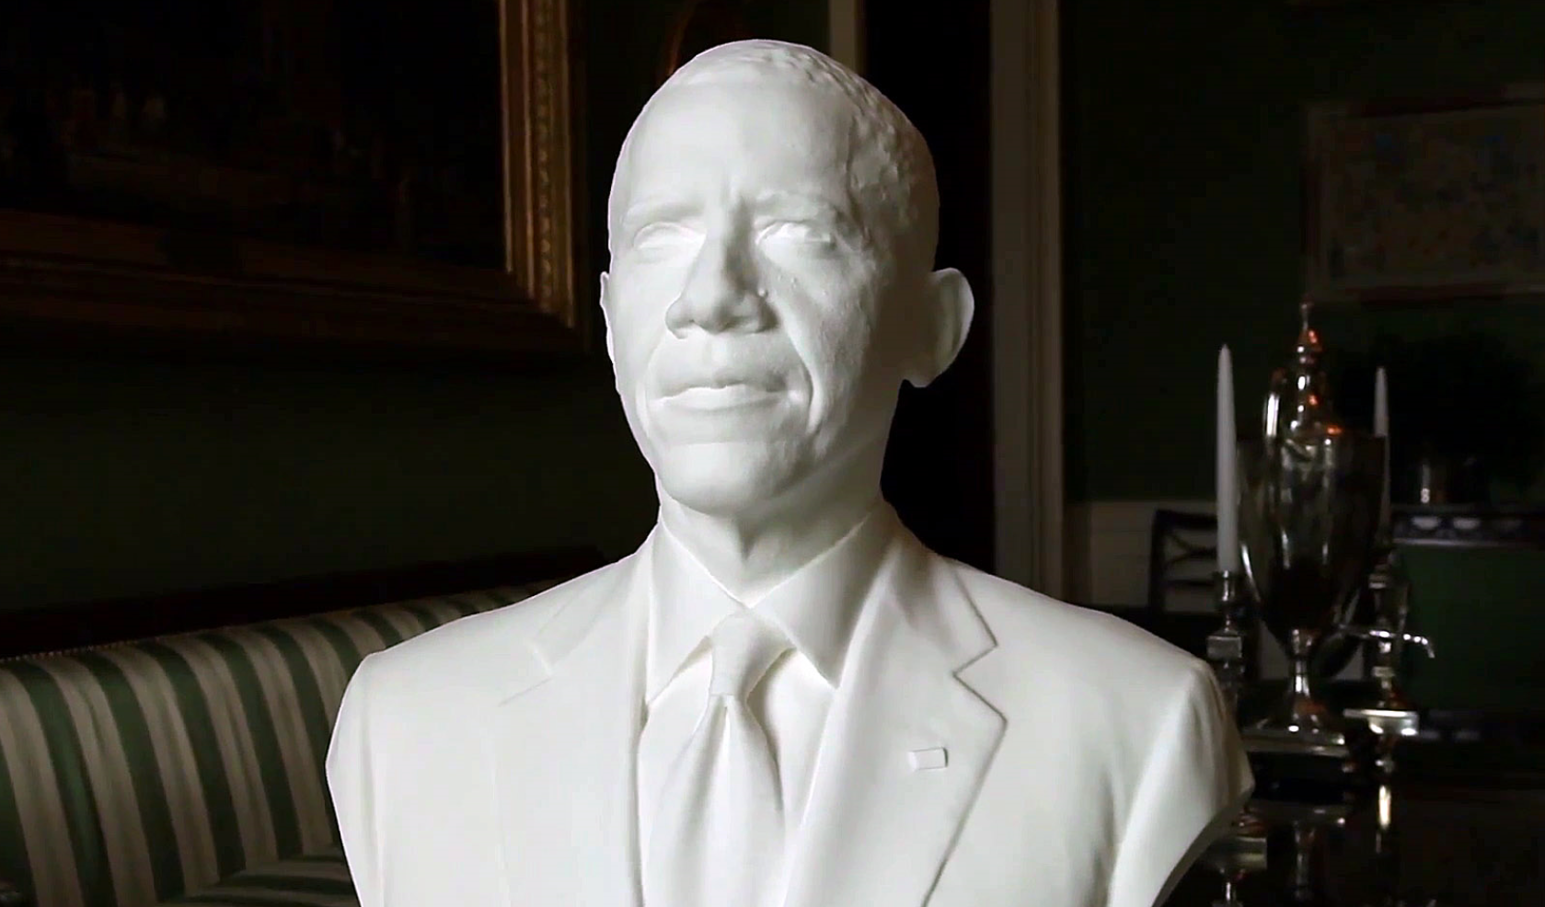
Computer Vision Applications
Human Shape Capture

Slide 25
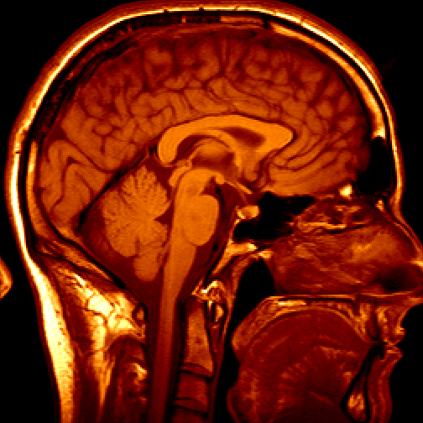
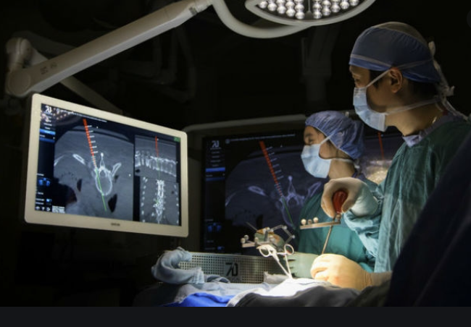
Computer Vision Applications
Medical Imaging
3D imaging
MRI, CT
Image guided surgery

Slide 26
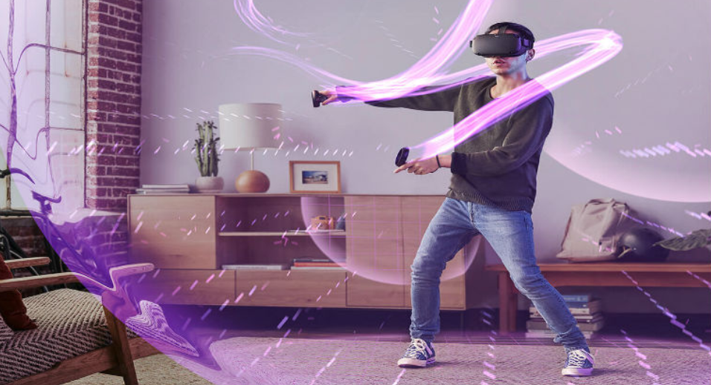
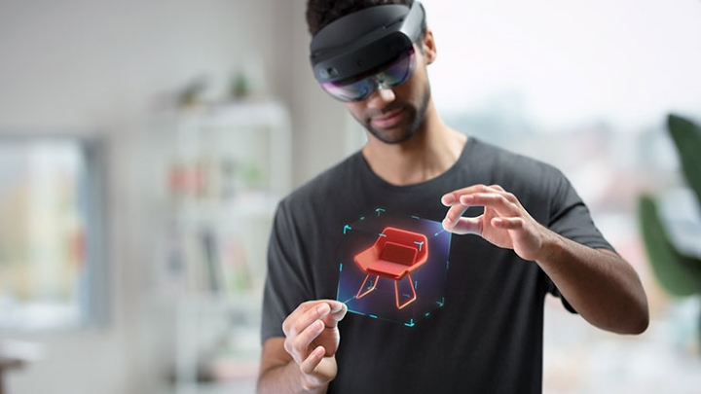
Computer Vision Applications
Virtual & Augmented Reality
Oculus Quest
Microsoft Hololens 2

Slide 27
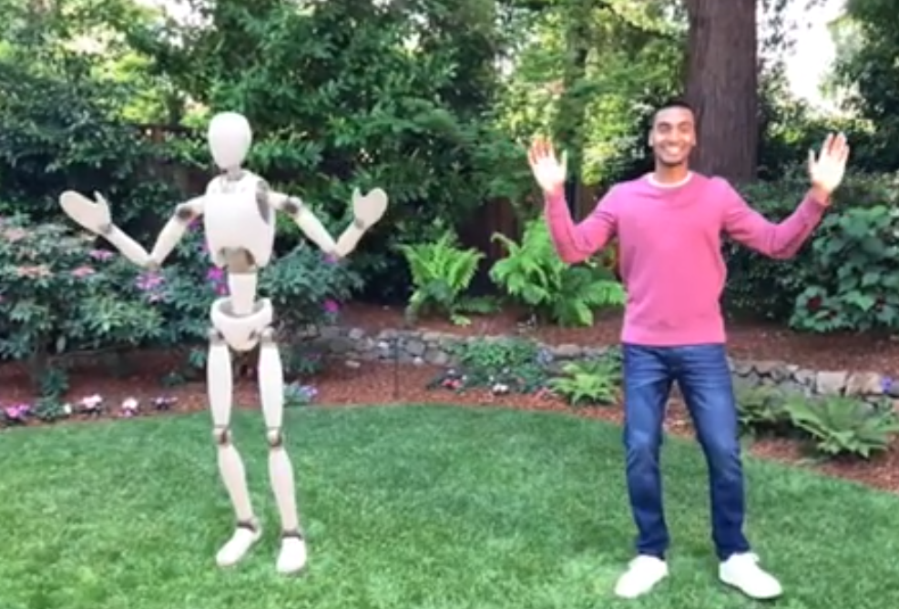
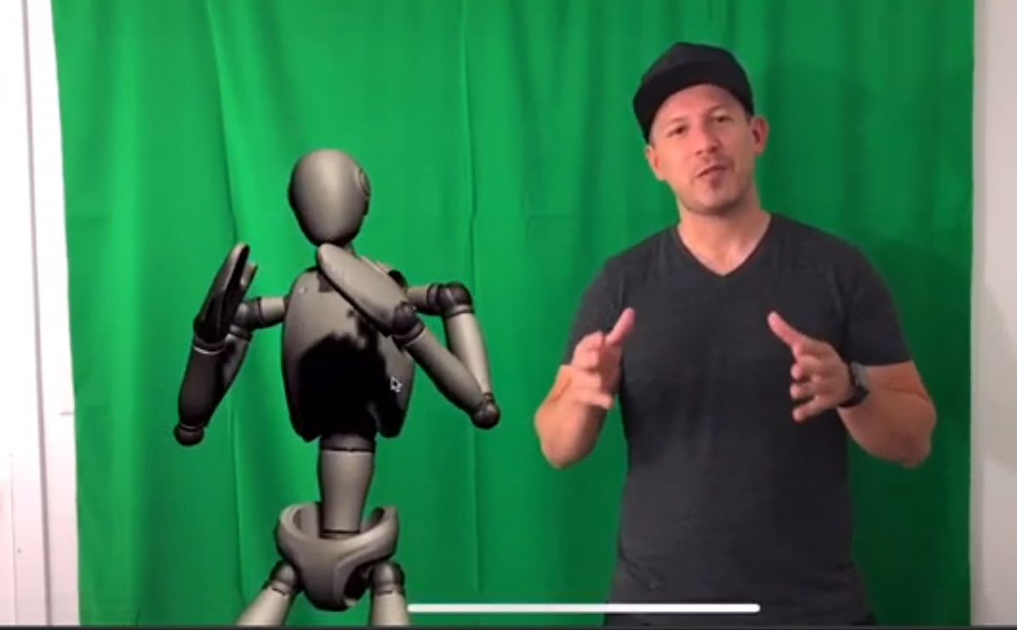
Computer Vision Applications
Body Tracking
ARKit 3

Slide 28
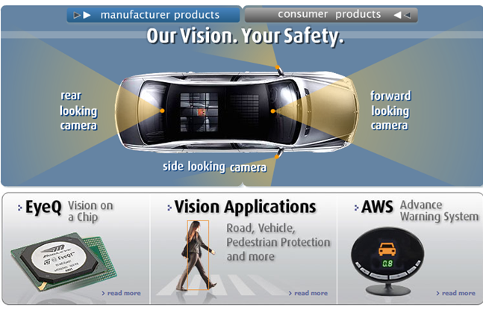
Computer Vision Applications
Smart Cars
Mobileye
Vision systems currently in high-end BMW, GM, Volvo models
BMW night vision

Slide 29
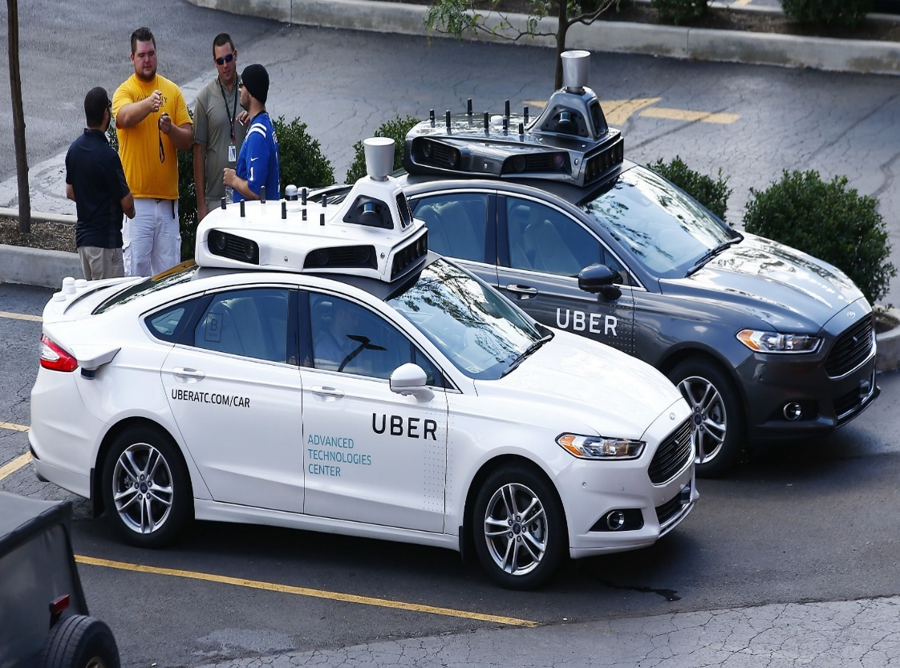
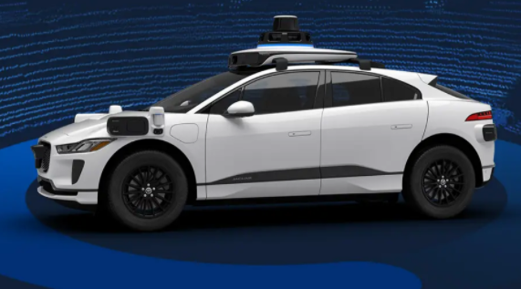
Computer Vision Applications
AutoCars: Self Driving Cars
https://waymo.com/tech/

Slide 30
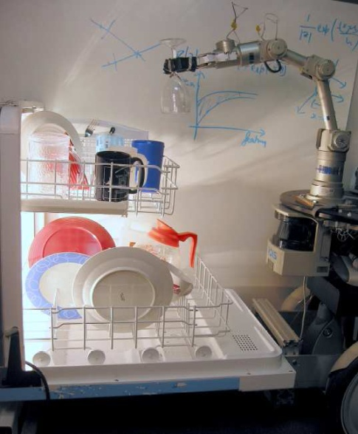
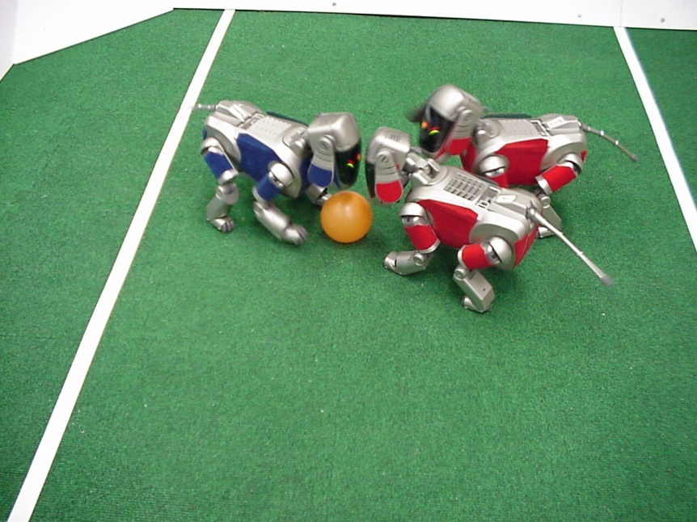
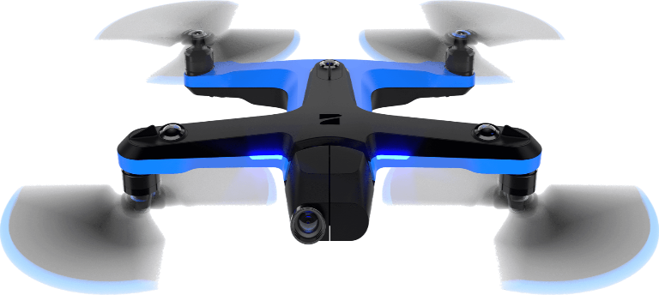

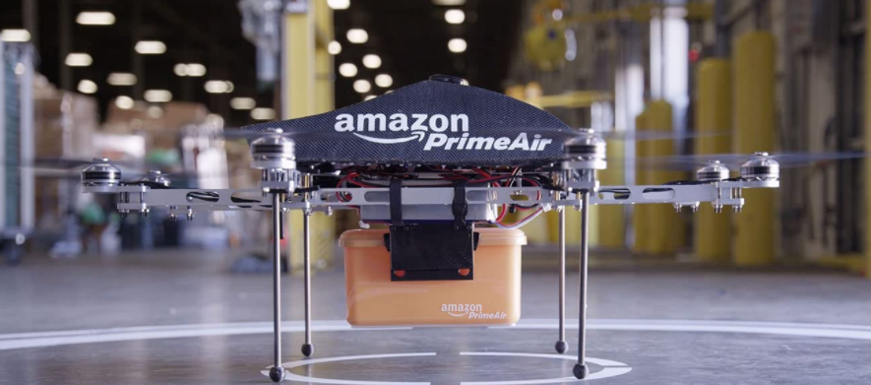
Computer Vision Applications
Mobile Robots
Saxena et al. 2008
STAIR at Stanford
http://www.robocup.org/
Skydio 2 drone
6x fisheye cameras for obstacle avoidance
Onboard NVIDIA GPU

Slide 31

Computer Vision Applications
Drones
https://www.skydio.com/

Slide 32


Computer Vision Applications
Industrial Robots
Vision-guided robots position nut runners on wheels

Slide 33
Convolutional Neural Networks (CNNs)

Slide 34
Convolutional Neural Networks (CNNs)
Convolutional Neural Network (ConvNet/CNN) is a Deep Learning network which can take in an input image, assign importance (learnable weights and biases) to various aspects/objects in the image and be able to differentiate one from the other.
Advantage: pre-processing required in a ConvNet is much lower as compared to other classification algorithms.
The architecture of a ConvNet is analogous to that of the connectivity pattern of Neurons in the Human Brain and was inspired by the organization of the Visual Cortex.
Individual neurons respond to stimuli only in a restricted region of the visual field known as the Receptive Field. A collection of such fields overlap to cover the entire visual area.

Slide 35
Why CNN?
A CNN can successfully capture the Spatial and Temporal dependencies in an image through the application of relevant filters.
Spatial Dependency: means that things closer together are more similar than things further apart in an image
Temporal Dependency: When a frame changes to next in a video, if there is not a lot of movement in objects, pixel's values remain same. In other words, a pixel's value is influenced by its value in previous frame

Slide 36

CNN
The role of the CNN is to reduce the images into a form which is easier to process, without losing features which are critical for getting a good prediction.
Filters in primitive CNN are often hand-engineered to extract desired features
Advanced CNN can learn the Filters by training them

Slide 37
Image Convolution
Image convolution is applying a filter that adds each pixel value of an image to its neighbors, weighted according to a kernel matrix.
The filter is defined as a MxM kernel matrix.
Convolving the filter with the image means sliding over the image spatially, computing dot products.
Doing so detects some desired features from the image and can help the neural network process it.
Different filters can detect different features.

Slide 38





Image Convolution
Suppose we have an image of size 5x5x1
Scanning an image with a “filter”
a filter is really just a perceptron, with weights and a bias
We have selected a filter as a 3x3 block
At each location, the “filter and underlying map values are multiplied component wise, and the products are added along with the bias
The filter may proceed by more than 1 pixel at a time
E.g. with a “hop” of two pixels per shift, called stride
Convolved
Map
Input Map

Slide 39





Image Convolution
“Stride” between adjacent scanned locations need not be 1

Slide 40
Image Convolution
Applying the following filter on an image performs edge detection
3x3 Filter
Original Image
Convolved Image
The idea here is that when the pixel is similar to all its neighbors, they should cancel each other, giving a value of 0. Therefore, the more similar the pixels, the darker the part of the image, and the more different they are the lighter it is.

Slide 41

Size of Convolution Result
Simple convolution size pattern:
Image size: N x N
Filter: M x M
Stride: S
Output size (each side) =
Assuming you’re not allowed to go beyond the edge of the input
Results in a reduction in the output size
Even if S=1

Slide 42




Size of Convolution Result
Image size: 5x5
Filter: 3x3
“Stride”: 1
Output size = (5-3)/1 + 1=3
Image size: 5x5
Filter: 3x3
Stride: 2
Output size = (5-3)/2+1=2

Slide 43
Convolution Layer
Each output is computed from multiple maps simultaneously
There are as many weights (for each output map) as
size of the filter x no. of maps in previous layer

Slide 44


Convolution Layer
We can view the joint processing of the various maps as processing a stacked arrangement of planes using a three dimensional filter
The computation of the convolutional map at any location sums the convolutional outputs at all planes

Slide 45




Convolution Layer
Consider a convolution layer with 2 input channels of size 4x4 each and one output channel with a filter size of 2x2 and a stride of 2. Determine the resulting output from this convolution operation for the given input values and the given filter values.
Size of output channel = (4 – 2)/2 + 1 = 2 x2
1st value = (2*1 + 1*2 + 1*1 + 2*2) + (1*5 + 2*6 + 2*5 + 1*6) = 42
2nd value = (2*3 + 1*4 + 1*3 + 2*4) + (1*7 + 2*8 + 2*7 + 1*8) = 66
3rd value = (2*1 + 1*2 + 1*1 + 2*2) + (1*5 + 2*6 + 2*5 + 1*6) = 42
4th value = (2*3 + 1*4 + 1*3 + 2*4) + (1*7 + 2*8 + 2*7 + 1*8) = 66
Output:

Slide 46




Convolution Layer
Filters always extend the full
depth of the input volume
Each input image has a different filter

Slide 47

Convolution Layer

Slide 48



Convolution Layer

Slide 49

Convolution Layer

Slide 50

Convolution Layer
Consider a second, green filter

Slide 51

Convolution Layer
For example, if we had 6 5x5x3 filters, we’ll get 6 separate activation maps
We stack these up to get a “new image” of size 28x28x6!

Slide 52
Convolution Layer
If we have 3 input channels of size 32x32 and 6 output channels and using a filter of size 5x5, then
The number of needed filters is 3x6 = 18 5x5 filters i.e. one filter for each input-output combination
The number of neurons is 6
The number of inputs to each neuron is 5x5x3=75
The number of network parameters to be trained (ignoring biases) is 5x5x3x6 = 450

Slide 53

Pooling Layer
Similar to the Convolutional Layer, the Pooling layer is responsible for reducing the spatial size of the Convolved Feature.
Pooling:
Decrease the computational power required to process the data through dimensionality reduction.
Useful for extracting dominant features which are rotational and positional invariant

Slide 54

Pooling
There are two types of Pooling:
Max Pooling returns the maximum value from the portion of the image covered by the filter.
Average Pooling returns the average of all the values from the portion of the image covered by the Kernel.
Max Pooling performs a lot better than Average Pooling since It discards the noisy activations altogether and also performs de-noising along with dimensionality reduction

Slide 55

Max and Mean/Average Pooling
There are no parameters to be learned during the pooling layer.
Number of output channels in a pooling layer is the same as the number of input channels of the pooling layer.
Max Pooling
Mean Pooling

Slide 56

Flattening
An image is nothing but a matrix of pixel values
Flattening refers to making a higher dimension array into one dimension as shown.

Slide 57

CNN Structure
Convolution, pooling and flattening then feeding to often a fully connected feed forward neural network for classification.

Slide 58

CNN Example: Le-net 5

Slide 59

CNN Example: Le-net 5
Digit recognition on MNIST (32x32 images)
Conv1: 6 5x5 filters in first conv layer, stride 1 => 6 28x28 maps
Pool1: 2x2 max pooling, stride 2 => 6 14x14 maps
Conv2: 16 5x5 filters in second conv layer, stride 1 => 16 10x10 maps
Pool2: 2x2 max pooling with stride 2 for second conv layer =>16 5x5 maps (400 values in all)
FC: Final MLP: 3 layers: 120 neurons, 84 neurons, and finally 10 output neurons

Slide 60

Example: Detecting Flower in an Image
Each neuron scans the image and “redraws” the input with some features enhanced
The specific features that the neuron detects

Slide 61

Example: Detecting Flower in an Image
The first layer looks at small sub regions of the input image; sufficient to detect, say, petals and enhances those
The second layer looks at regions of output of the first layer
To put the petals together into a flower
This corresponds to looking at a larger region of original input image
We may have any number of layers in this fashion

Slide 62

Example: Detecting Flower in an Image
The rectangular maps of the neurons in the final layer of the scanning network will generally be reorganized into a vector before passing them to the final softmax or MLP
The flower will be detected regardless of its position in the image

Slide 63

CNN Learned Features

Slide 64

CNN Learned Features

Slide 65
CNN Demo
CNN Explainer
Demo Video
https://cs.stanford.edu/people/karpathy/convnetjs/demo/cifar10.html

Slide 66
Summary
The convolutional neural network is a supervised version of a computational model of mammalian vision
It includes
Convolutional layers comprising learned filters that scan the outputs of the previous layer
Downsampling layers that operate over groups of outputs from the convolutional layer to reduce network size
The parameters of the network can be learned through regular back propagation

Slide 67
Acknowledgments
Slides have been used from:
https://deeplearning.cs.cmu.edu/F20/index.html
http://cs231n.stanford.edu/syllabus.html
https://towardsdatascience.com/a-comprehensive-guide-to-convolutional-neural-networks-the-eli5-way-3bd2b1164a53

